Slide 1

What is consultancy -
and where does it come from?
Notes:
Hi

Slide 2
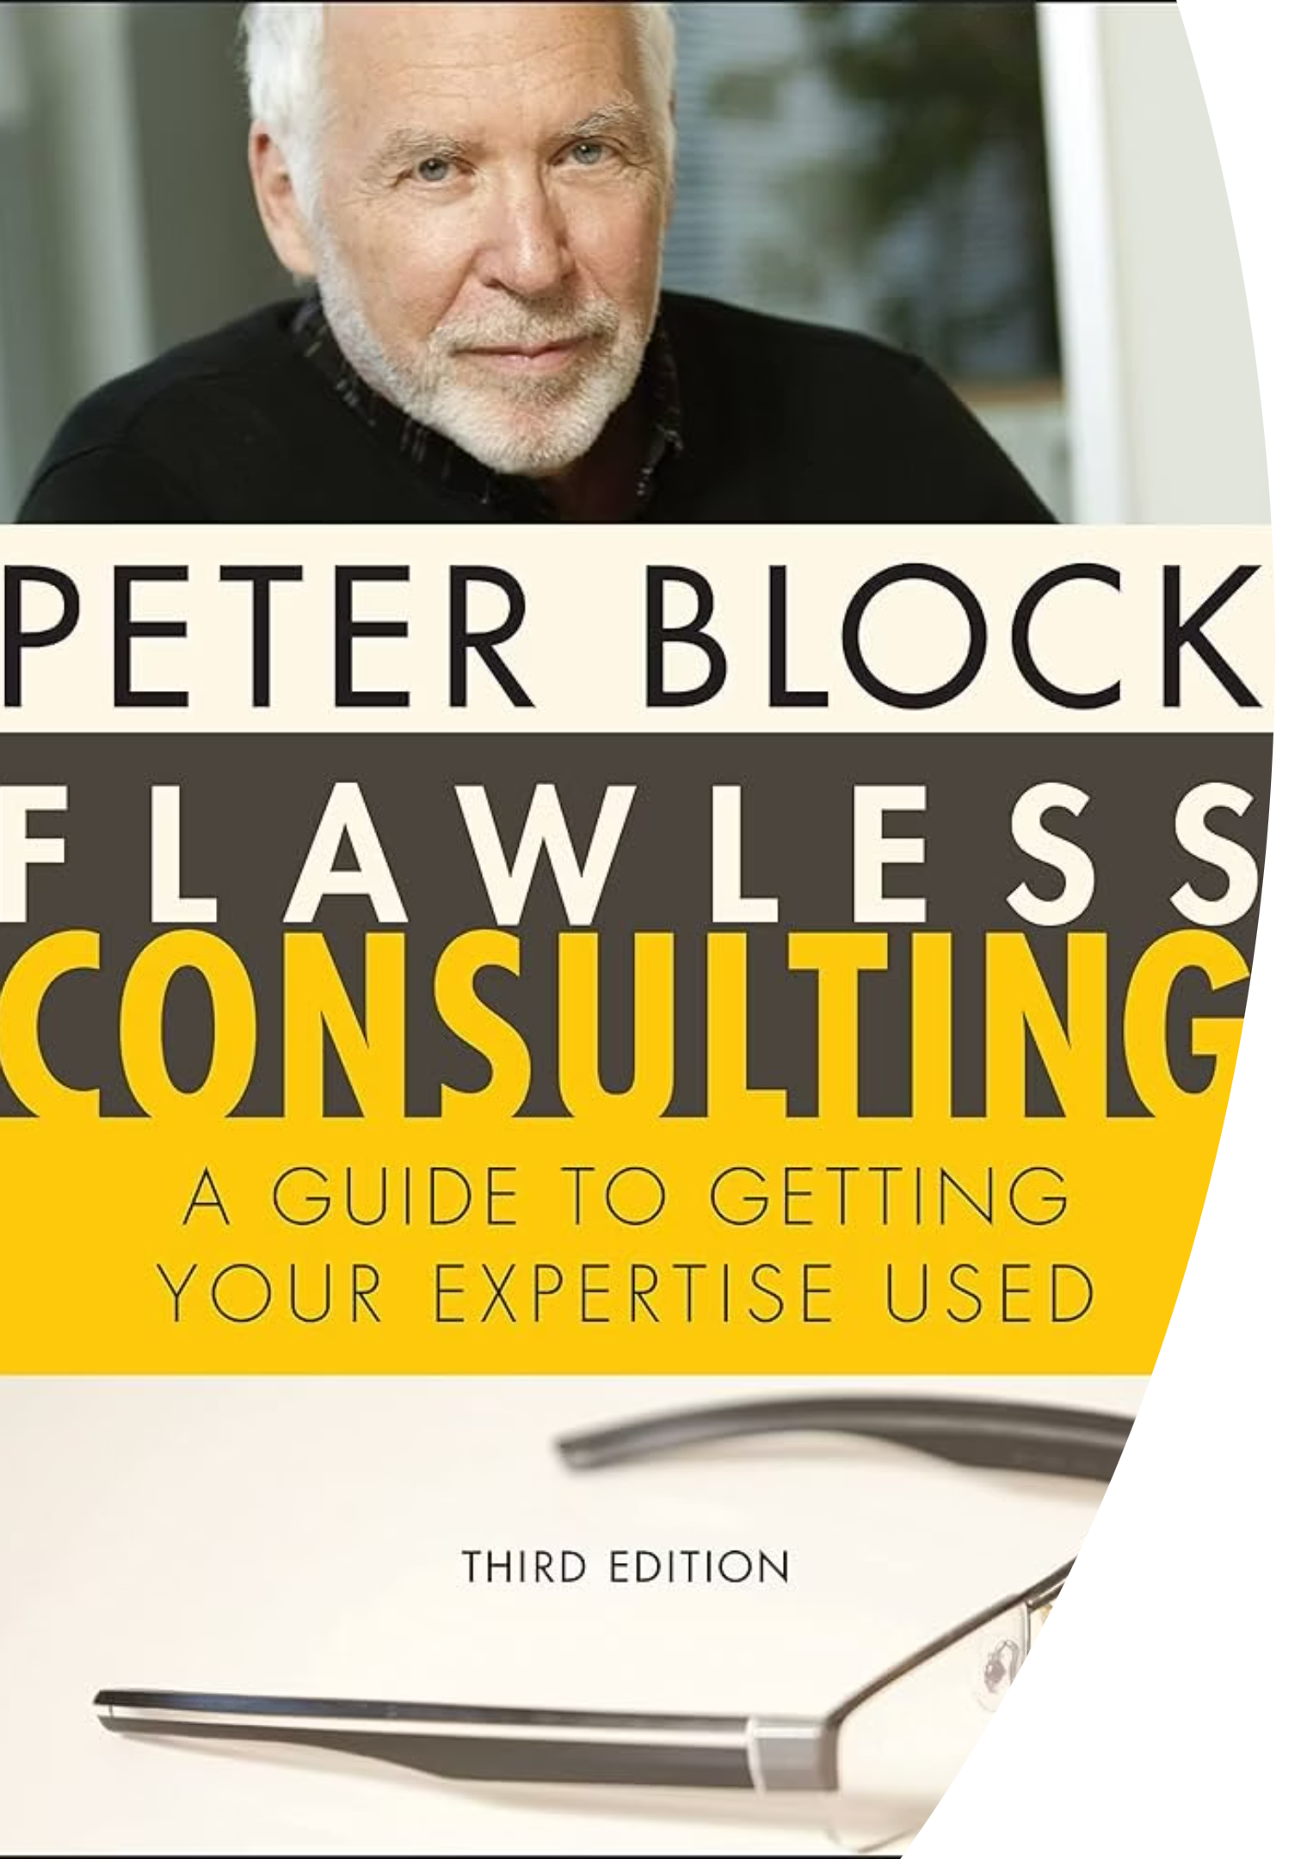
KEY DEFINITION
"You are consulting every time you are trying to change or improve a situation but have no direct control over the implementation."
— Peter Block

Slide 3
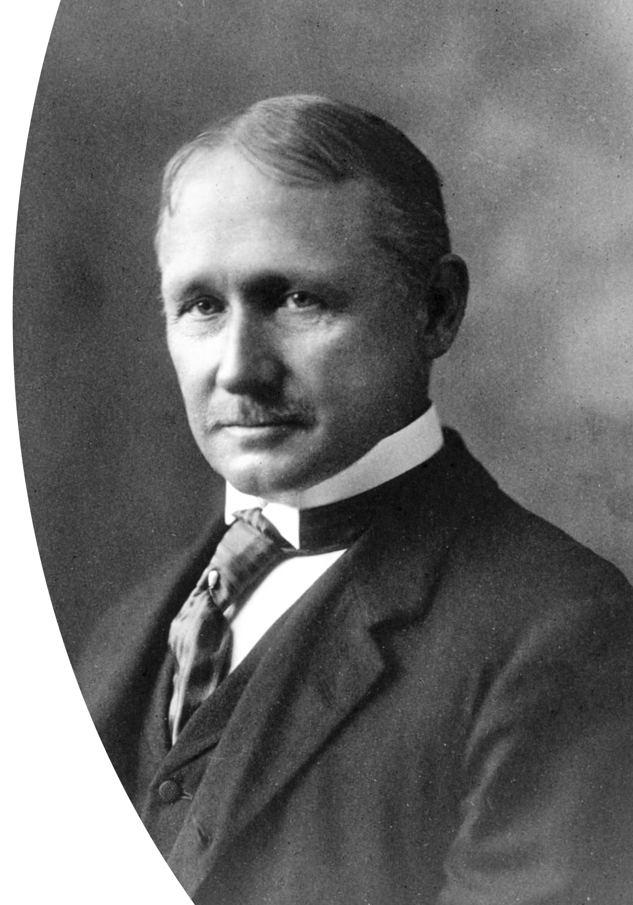

A Man and His Shovel
Spring 1898
Frederick Winslow Taylor arrives at Bethlehem Steel.
The Problem
Bethlehem is making cannons for the Spanish-American War and can't keep up.
The Discovery
Taylor measures and experiments with shovels. He discovers the sweet spot: 21 pounds per load.
The (Claimed) Result
140 workers now do what 500 did. Daily output per man jumps from 16 tonnes to nearly 60.
This is one origin story of consultancy - a radical idea: work itself can be studied and improved. Not by the people doing it, but by someone standing back and analysing it.

Slide 4
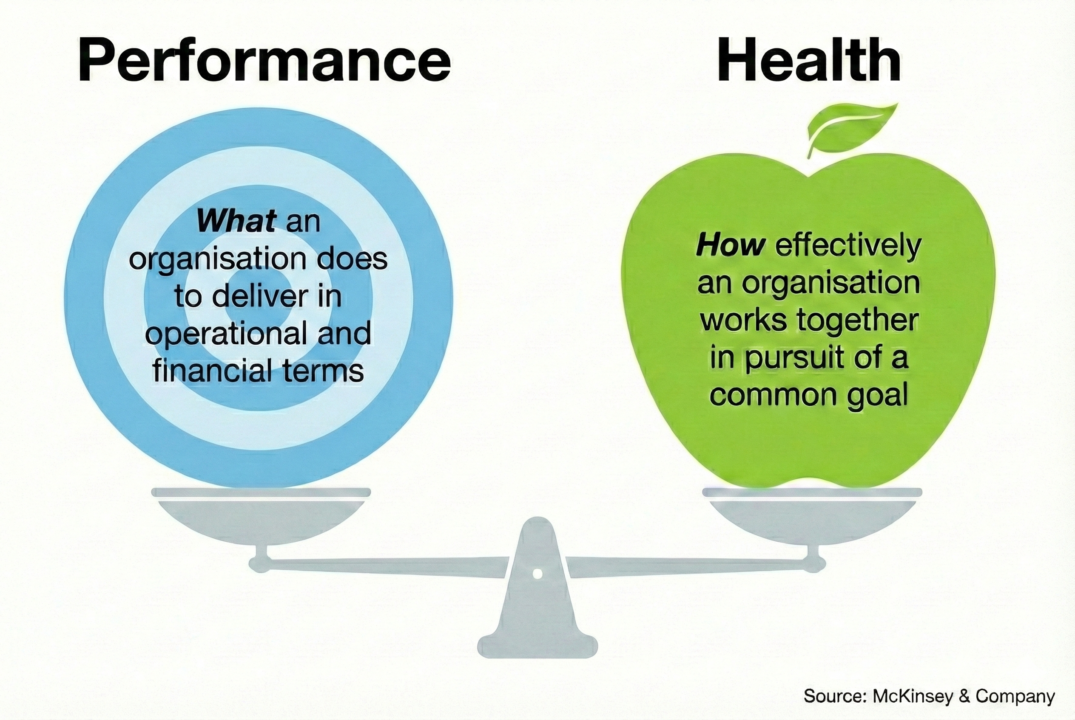
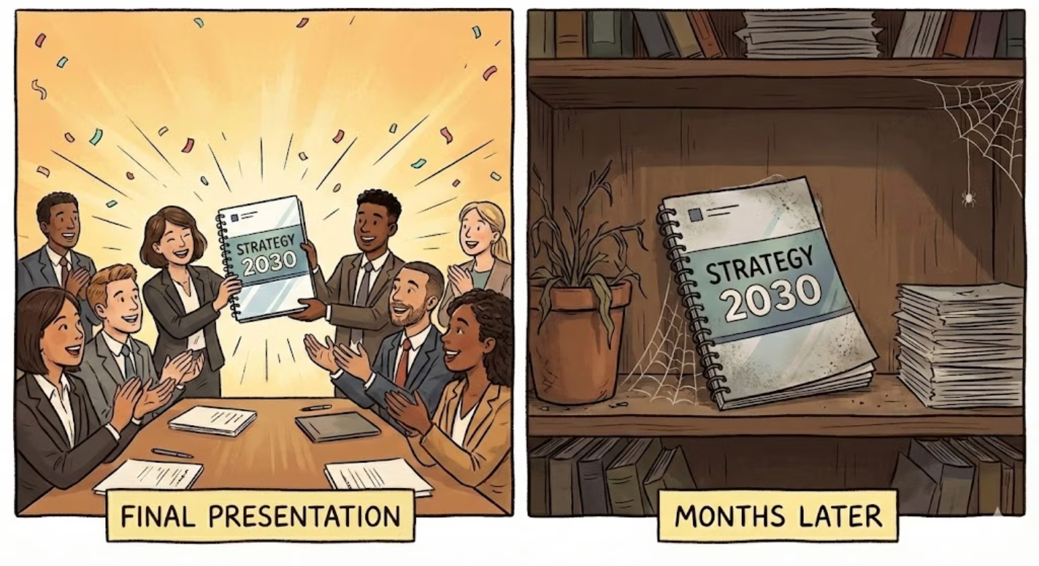
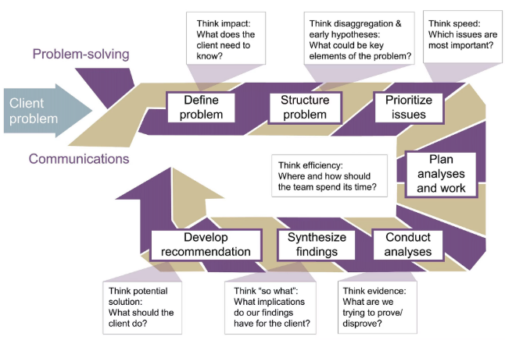
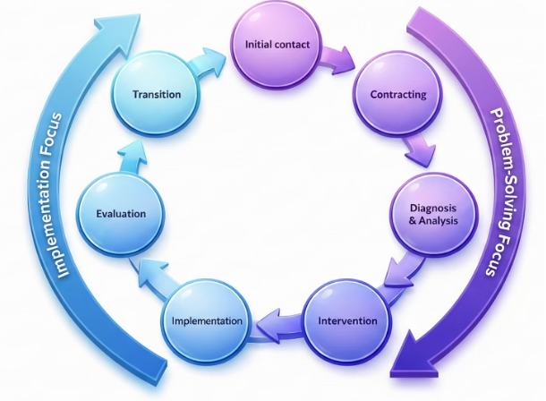

Some Catches
Consulting (often) needs to be more than problem-solving. Problem-solving includes stakeholder communication … and the full consultancy-cycle goes beyond.

Slide 5

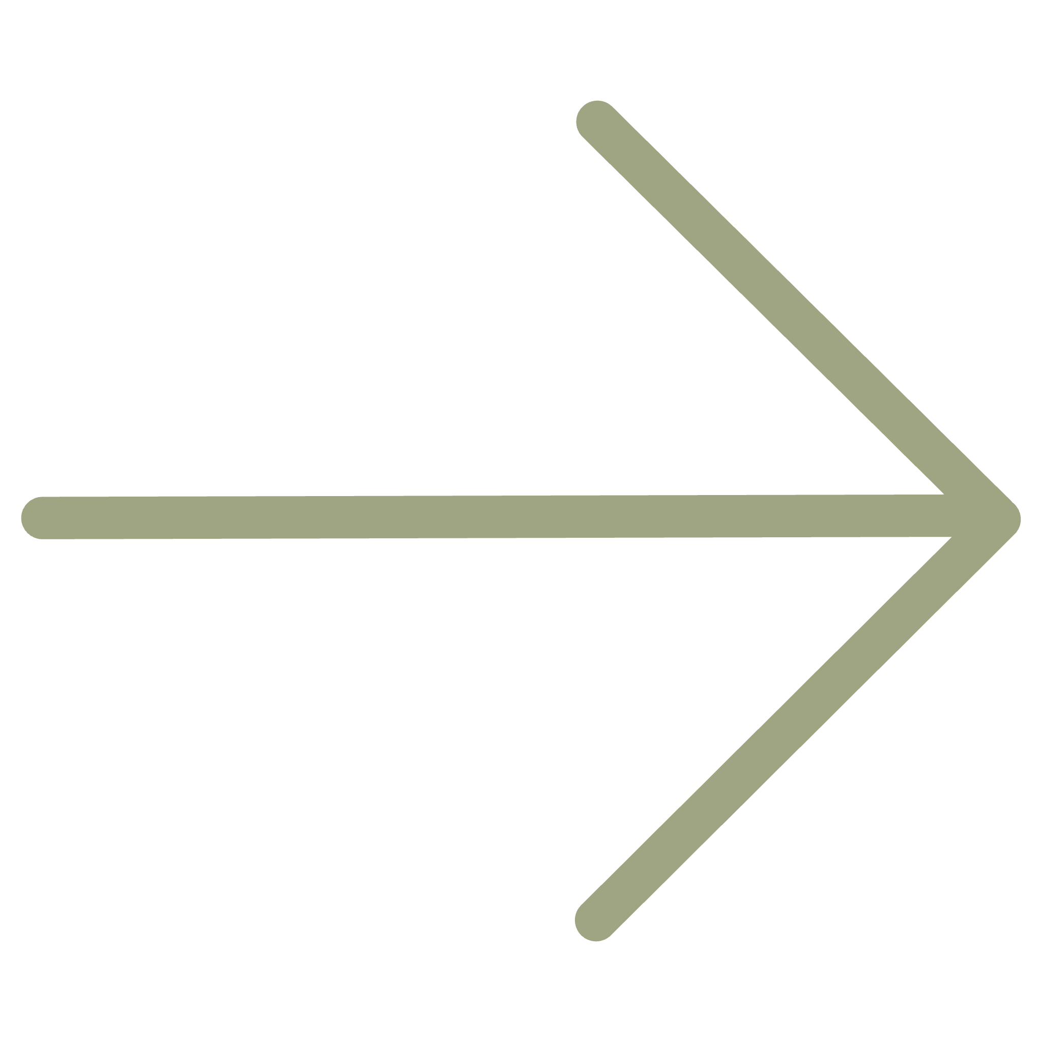
Your Reflection
Think about a time you tried to change something at work without having direct authority.
What made it hard? What helped?
Bring that experience to the live session. We will discuss what it takes to be a good consultant.
COMING UP NEXT
The industry that turned scientific management advice into a $300 billion business.

